Slide 1
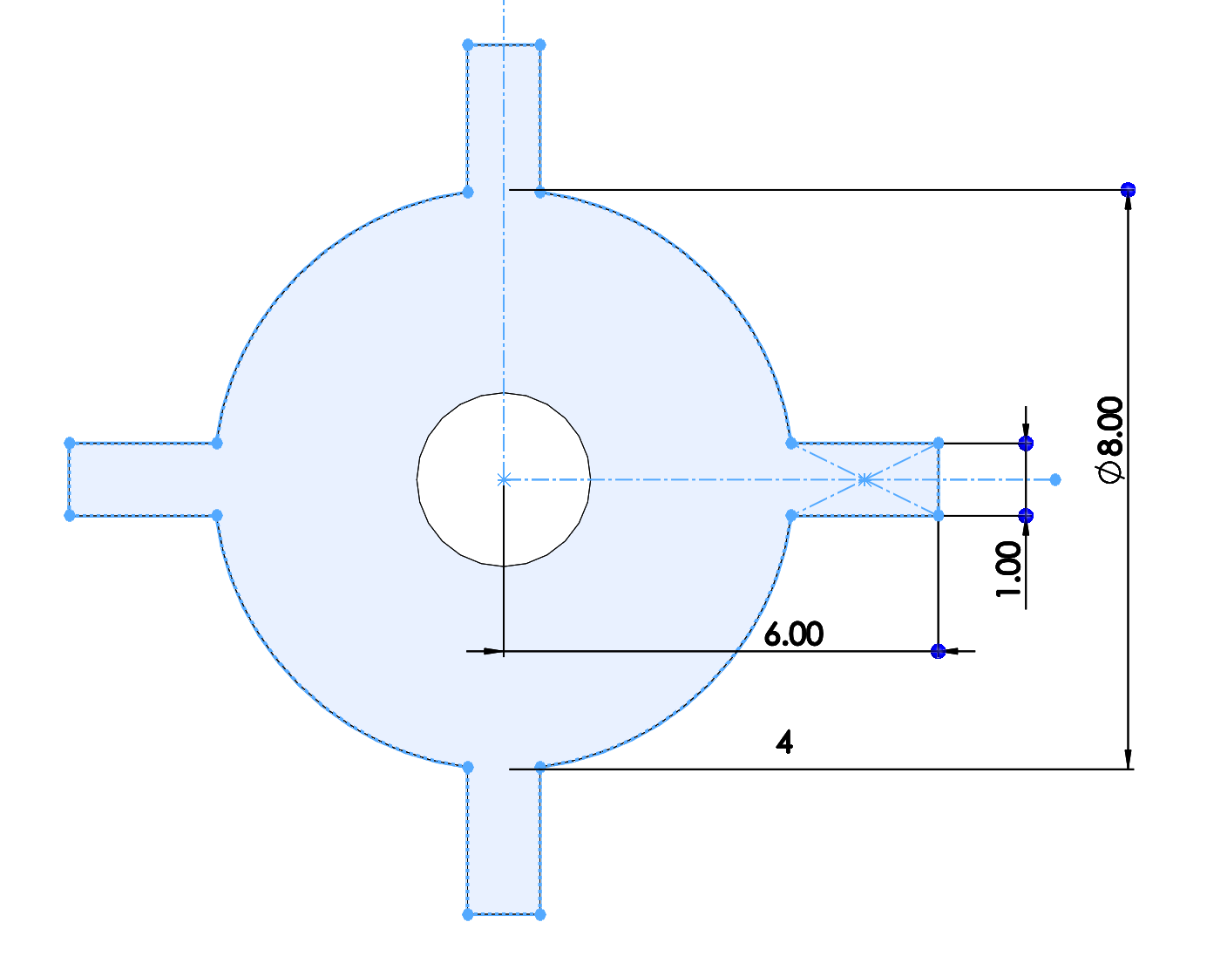


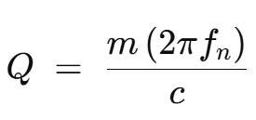

Rotor parameter
Rotational mode
Iz(kg*m^2) | 4.64E-10
Ix,y (kg*m^2) | 2.33E-10
Measured µ/I 4.76E-04
X, theta, Z modes
Mass(g) 0.0414
measured
f(Hz) | Q
8.83 | 22
17.89 | 19
22.31 | 13

